Slide 1
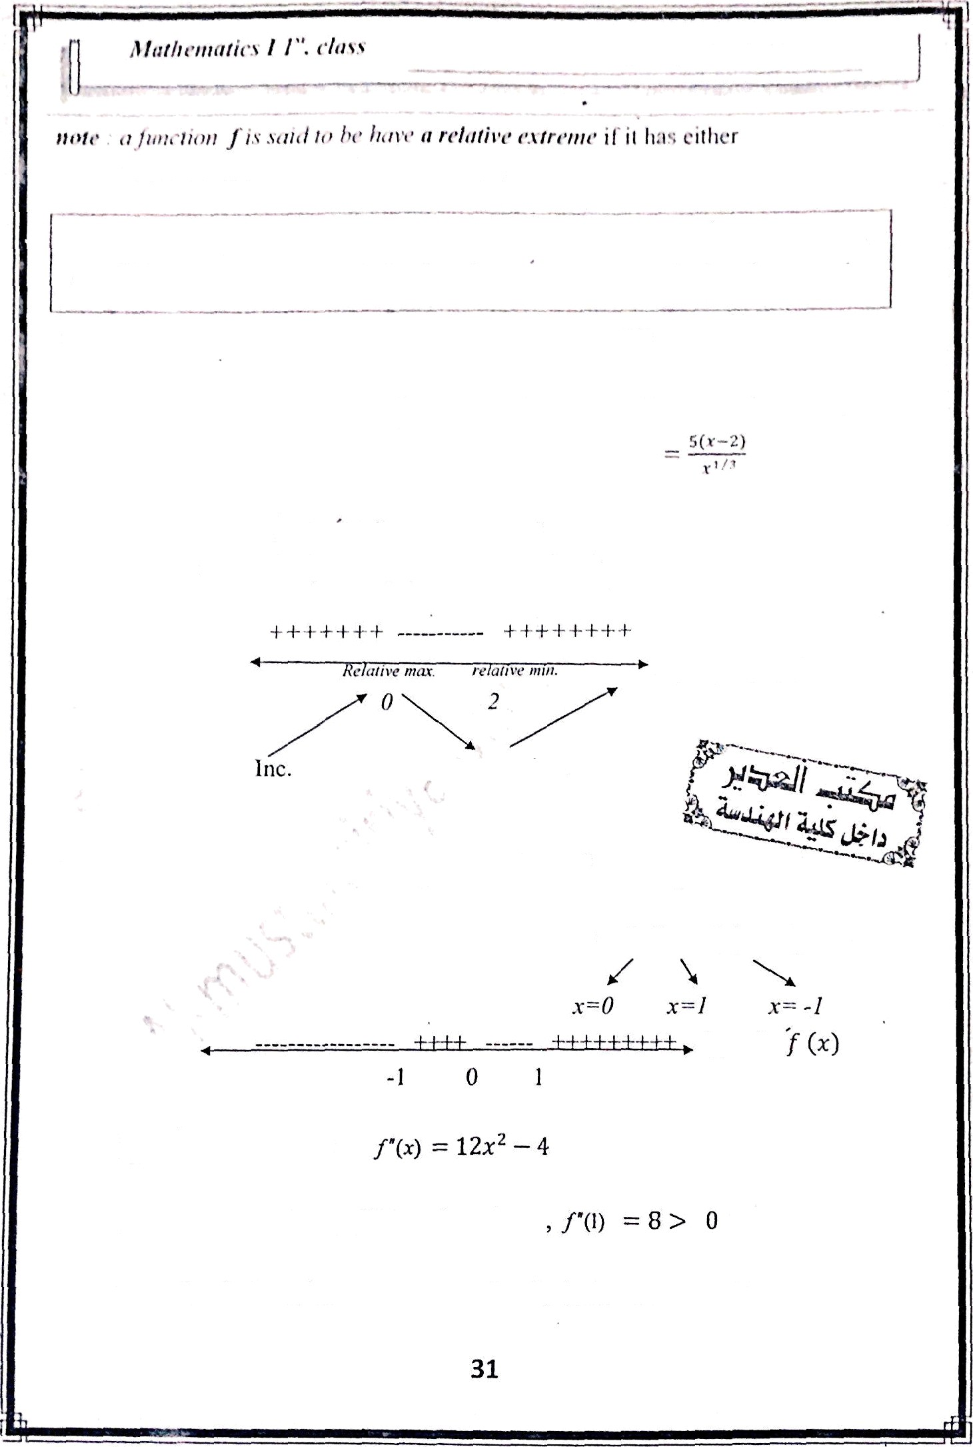
llcç.: it ctiıic;ıl pt›iııt tt< it l”tıııvtiıııı / is tiny viıloc ‹›l ı sut lı tlıiıı j (r) =- Il t'r./ i• lıt,t tlill;.rcııtiiıl,lc ;ıııtl the ci it iciıl bitirin where / (›) = 11 is ciıllctl sliılitıeiıry Pt'inl
) (›)
= îi›:”'^ -
10.*”*'^{J}
= îî .‹- °'* (.‹ - 2)
f“ (x) ‹lc›c's ıtı›/ r.vi«f ın x‘-- û
ntt‹l pX -- 0 1Ymefl x —=’
/f«' cı iticctl poittls of f art' x—0 ntıJ.x -2
Sign of
’f (x)
, Jec.
inc.
Ex: locate the relative extı•emc of f(x) —- x⁴ — 2x'
f! (x) —- 4x'
— 4x — 4x(x' - 1)
= 4x(x — 1)(x + 1) = 0
sign of
by 2“. derivative test
f’(-i )= -4 •z 0 , /‘(0) = 8 Y 0
There is relative min. at x-/.,vd x=-7 and relative max. at z=0

Slide 2
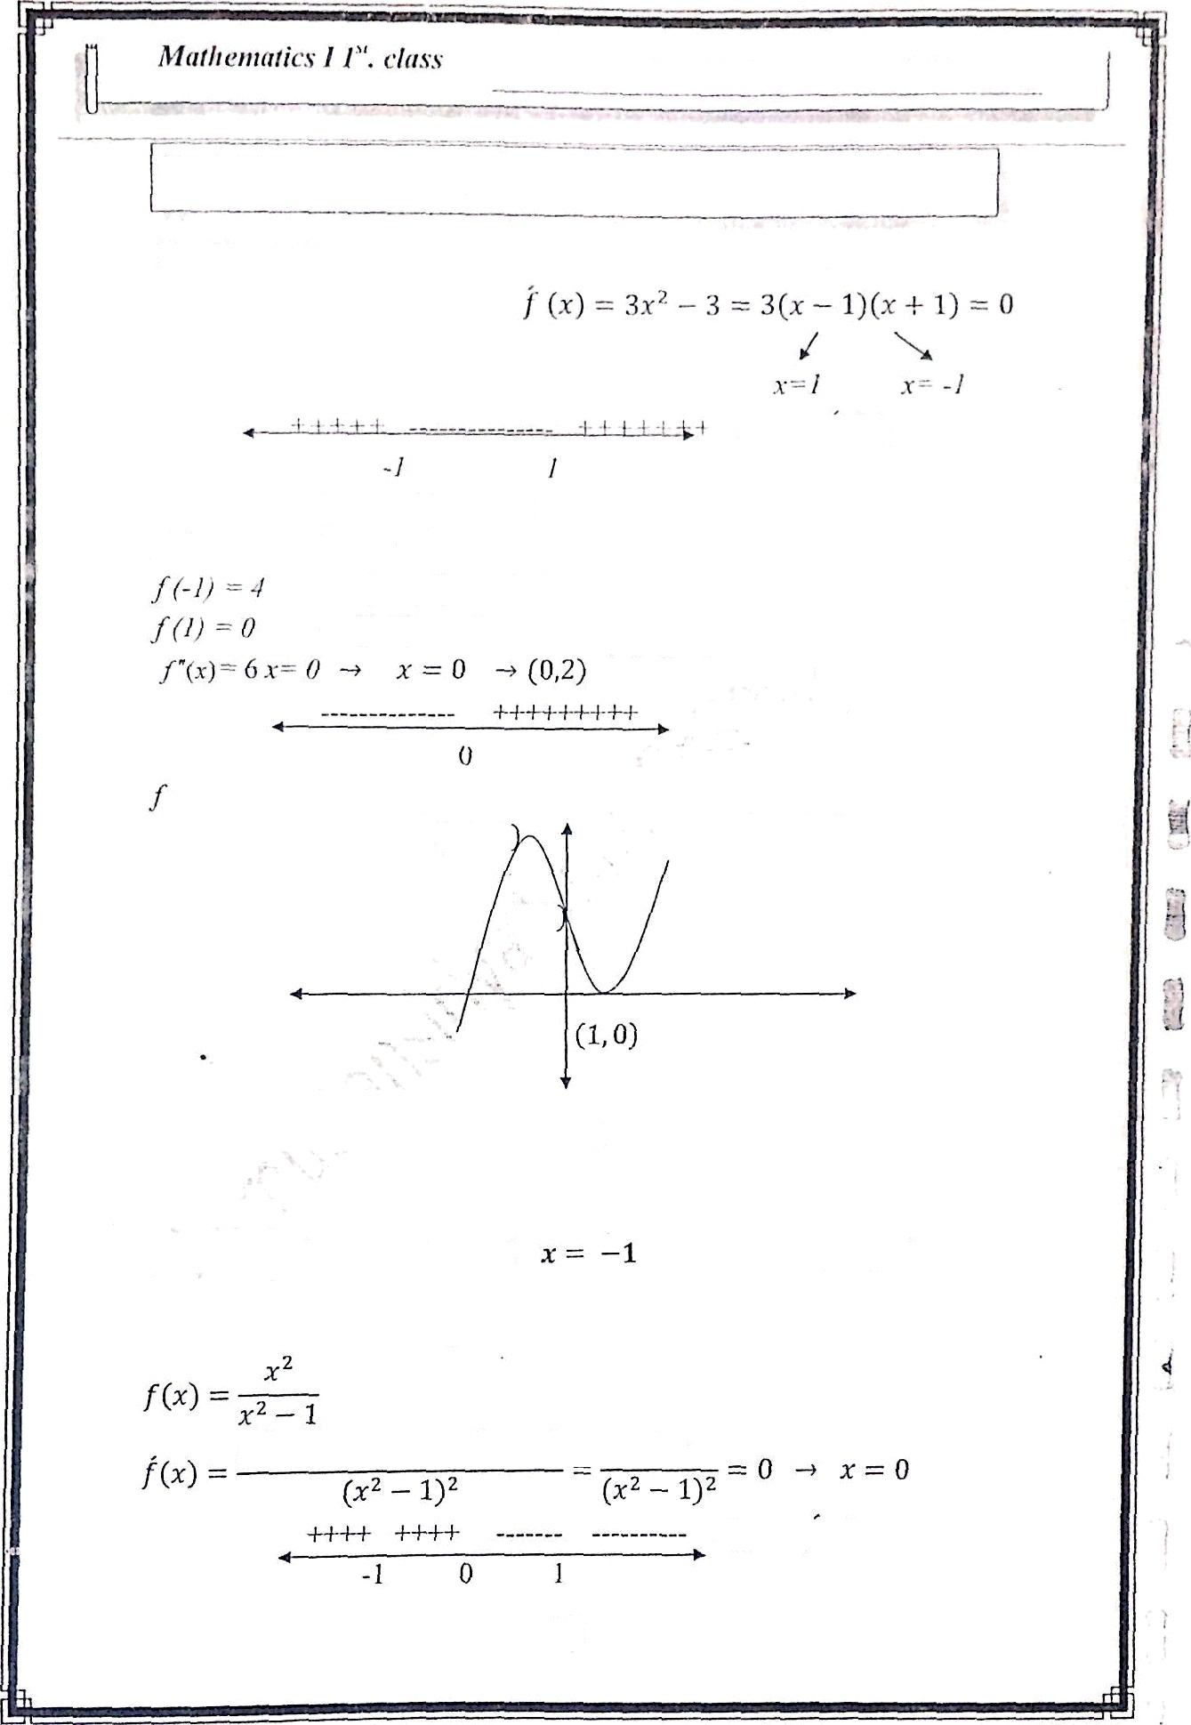


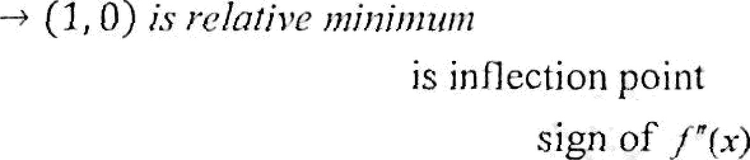



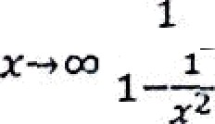


lest. Wrof. : Af›tx›s $*. Al-shiitzi»«ry
*" " '**ii •'”^I*l's of li‹›l1'notiii:ils a nil Itati‹iiial fuiictioiis
F.x: Sketch t he graph of tt›t curve f (x) — x" 3.r 1 2
is concave up on (0, ) anil concave down on ( - , 0)
(- 1, 4
(o z
- .!
Ex: sketch the graph of
f[x)
2
ix-1)(xml) = 0 —• x • 1
rind
are vertical asymptote.
y --1 is Horizontal asymptote
lim
;-1
(r' 1). (2x)
( ²). 2z)
sign of f(x)
32

Slide 3
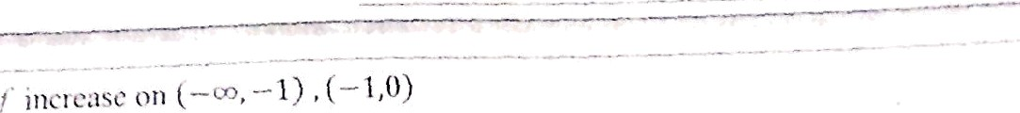

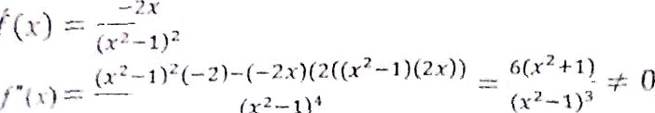
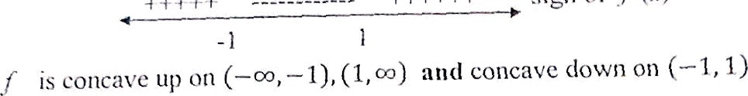
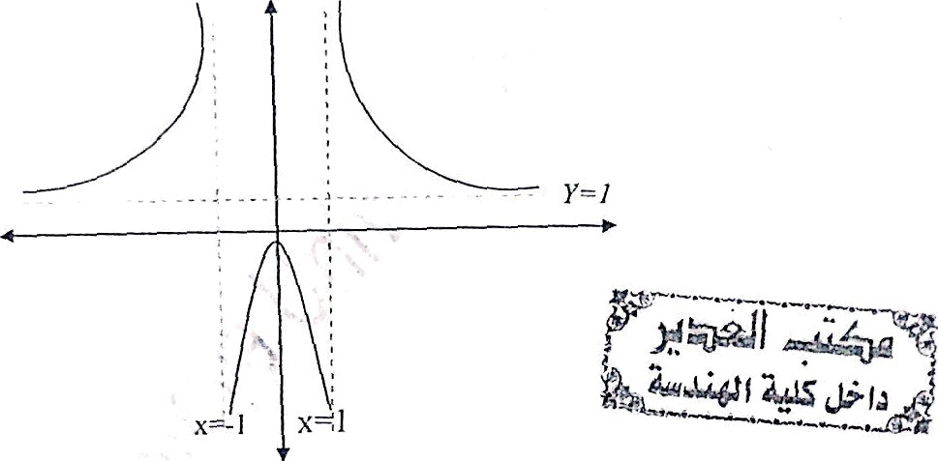


1
Ex: Sketch the graph of the rational functi0n
z° — 0 —› z = 0 is the vertical asymptote There is no Horizontal asymptote
f(x) — $,
_{— x}3
+4
(zJ) —3z') — (4
f“(X ) —‘
)(2x)
33

Slide 4
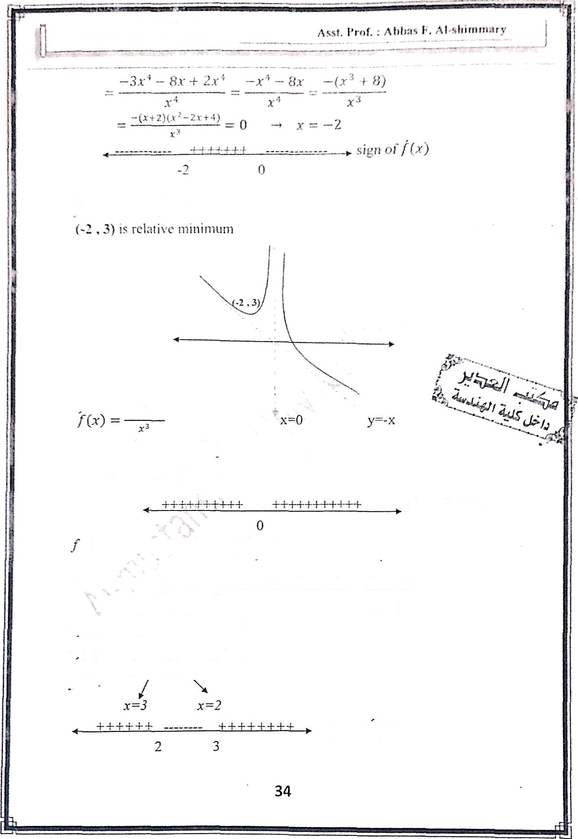
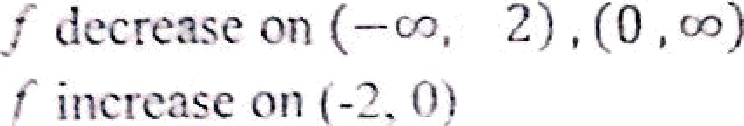




] ( —3x
²) -t- x'
+ 8)(3x²)
24
There is no inflection point
sign of f‘( )
-
is concave up ön (- , 0), JO, )
Ex . Find tbe absolute max. and absolute min. values of
3
(m) — 2 15 x' + 36 x on the interval (1, 5]
f(x ) — 2x³ — 15 x’ + 36 x
/ (x ) 6 x’ — 30 x + 36
f (x - 3)(x 2) — 0
sign of f (x )

Slide 5

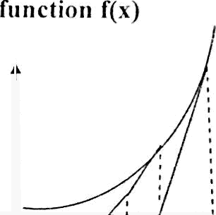



/ ( I )— 23
(my—. o¿
f ( 3)=? 7
(?, ?.S) iS rel.at ive in:Ix. btlt (5, 55) iS ;lbsOl Ulc ,pp,
, 7) Is rc iJlivc ruin but (l, ?S) is al›soltilc min
SCH't(Ill Illiit IIOtl:
llscd lo fi titl t lic rt;ots of (J;c
NulilericuIl3'.
f‹•›
n+1
Ex: use ncivtou method to approximate tllc solution of
y3
x 1 = 0
y{1)=- 1 and )(2)=5
the sign is vary for the function
between x— I and x=2 so the root lie between them ,choose x- = 1. 5
X | -? | -1 | 0 | 1 | 2 | 3
/(x) | - |  | - | - | + | +
let „€(x) x ³
f[x ) 3x' — 1
_
x — 1
³ — > — 1
“+
1
“
3x ²» —
(1.5)³ — (1.5)—
_{s}( - )2_ ₁
— 1.34782609
x;; = 1.34782609
(1.34782609) ³- (1,347826 0
*' 1.32520040
3(1.34782609)'— 1
x4 1.32471817
xt 1.32471796
x ₆ 1.32471796
No need to continue because we reached the accuracy so
x -= 1.32471796
35

Slide 6
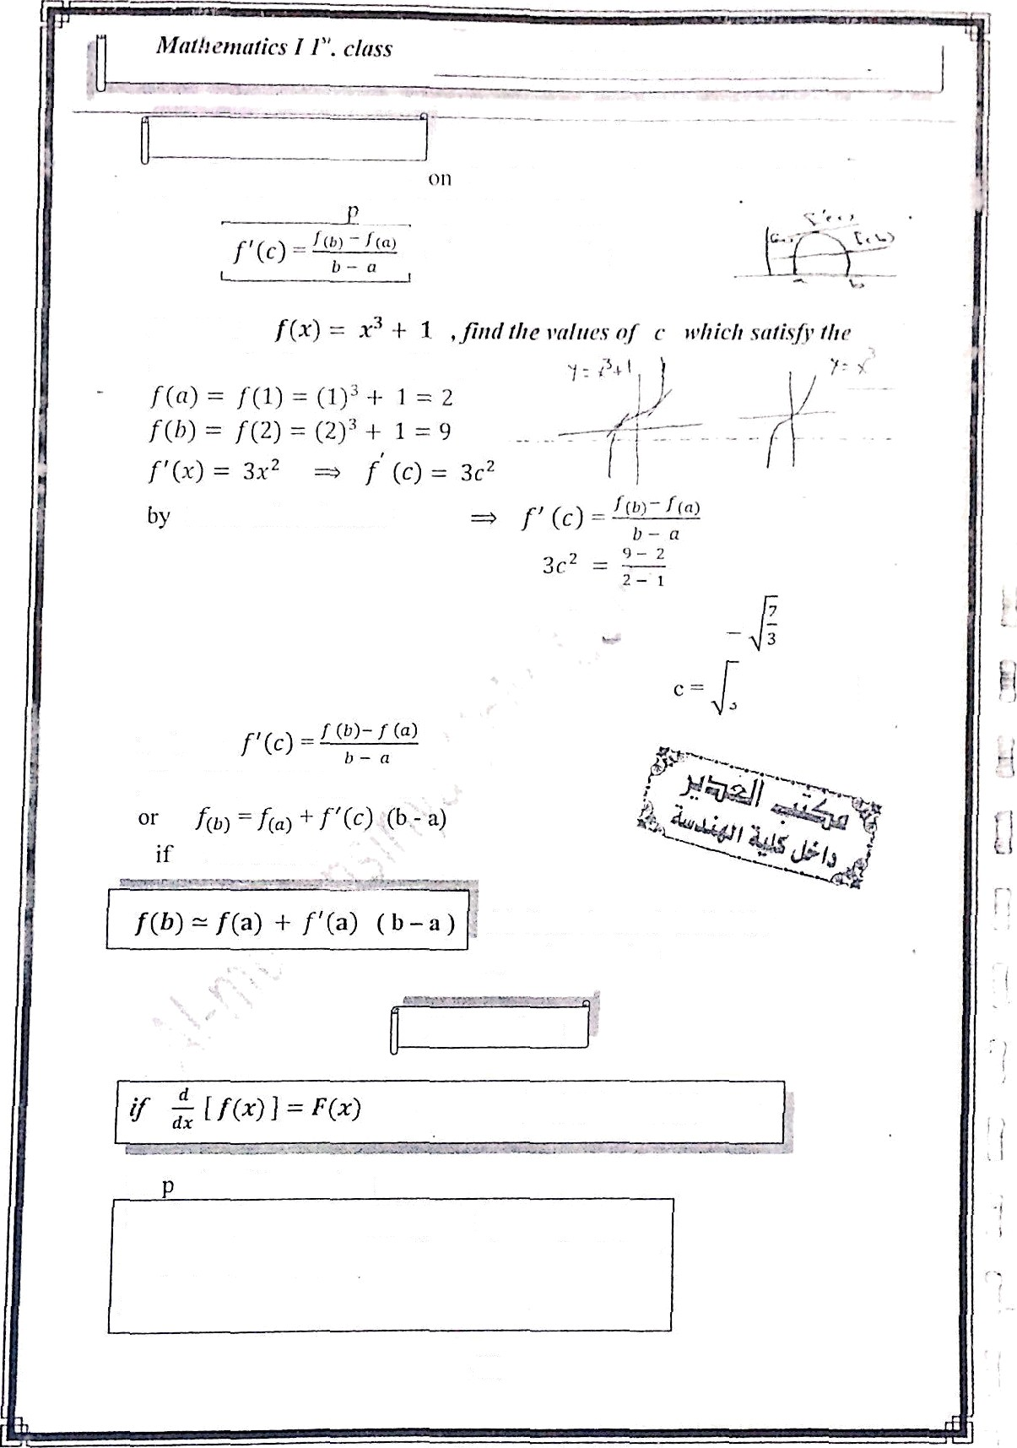
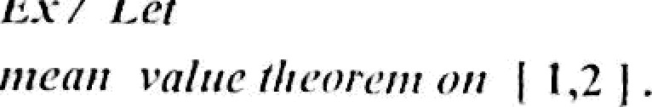
Mciltl Yaltlv T licorciii:
where c e t , b )
mean value theorem
3c ²
— 7 c —- +
7
* t i z j
nDte:
f(b) -f fa) -— f’(c) ( b — a )
a c then
this formula used to find the
approKimate value
Integration
Pro erlies of integration:
f c f(x) dx —- c
f(x) g (x) ) dv -
(x dv
f( ) dx
( dv
36

Slide 7
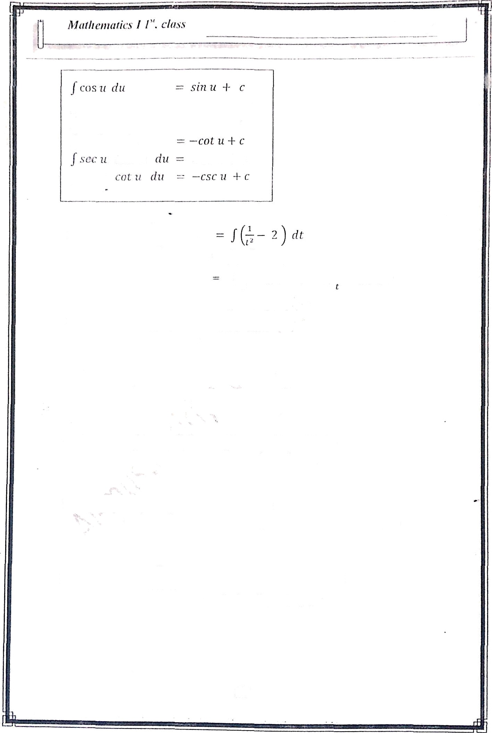


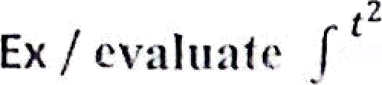








/ .si›i u | dii |  | —cos u | + c
J :ioc' ii | du | = | tan u | -I- c
[ c;c2 ii | du
 |  |  | sec u | -J- c
- i i' _{dt}
—— r* ² — 2 )dr
—*_{i}' - 2 t + c
1
/(
= - — 2 f -l- c
EK / Evaluote
COSJ
d*=/ _{sin}
x sin x
dx
—— J csc x cot x dx —— - csc x + c
Ex / cvaluatc / x^{i} IÑ dx = / x³ x''' dX
= / x⁷'' dz —
Ex / evaluate /(2 + y' ) ² dy = }( 4 + ₃⁴₊^{y 2}
4)
dx
'4y+*3
›'
Ex / eva‘)pat‘e f sec x (sec x + tan z ) dx
— f( sec’ x + sec x tnn x ) dx —— trim x + sec x + c
Ex / evaluate / ^{COS' & —}
d8 —— J( cos 8 — 5 sec²
= sin 8 — 5 tan 8 5- c
) _{d}
cos ² 8
37

Slide 8
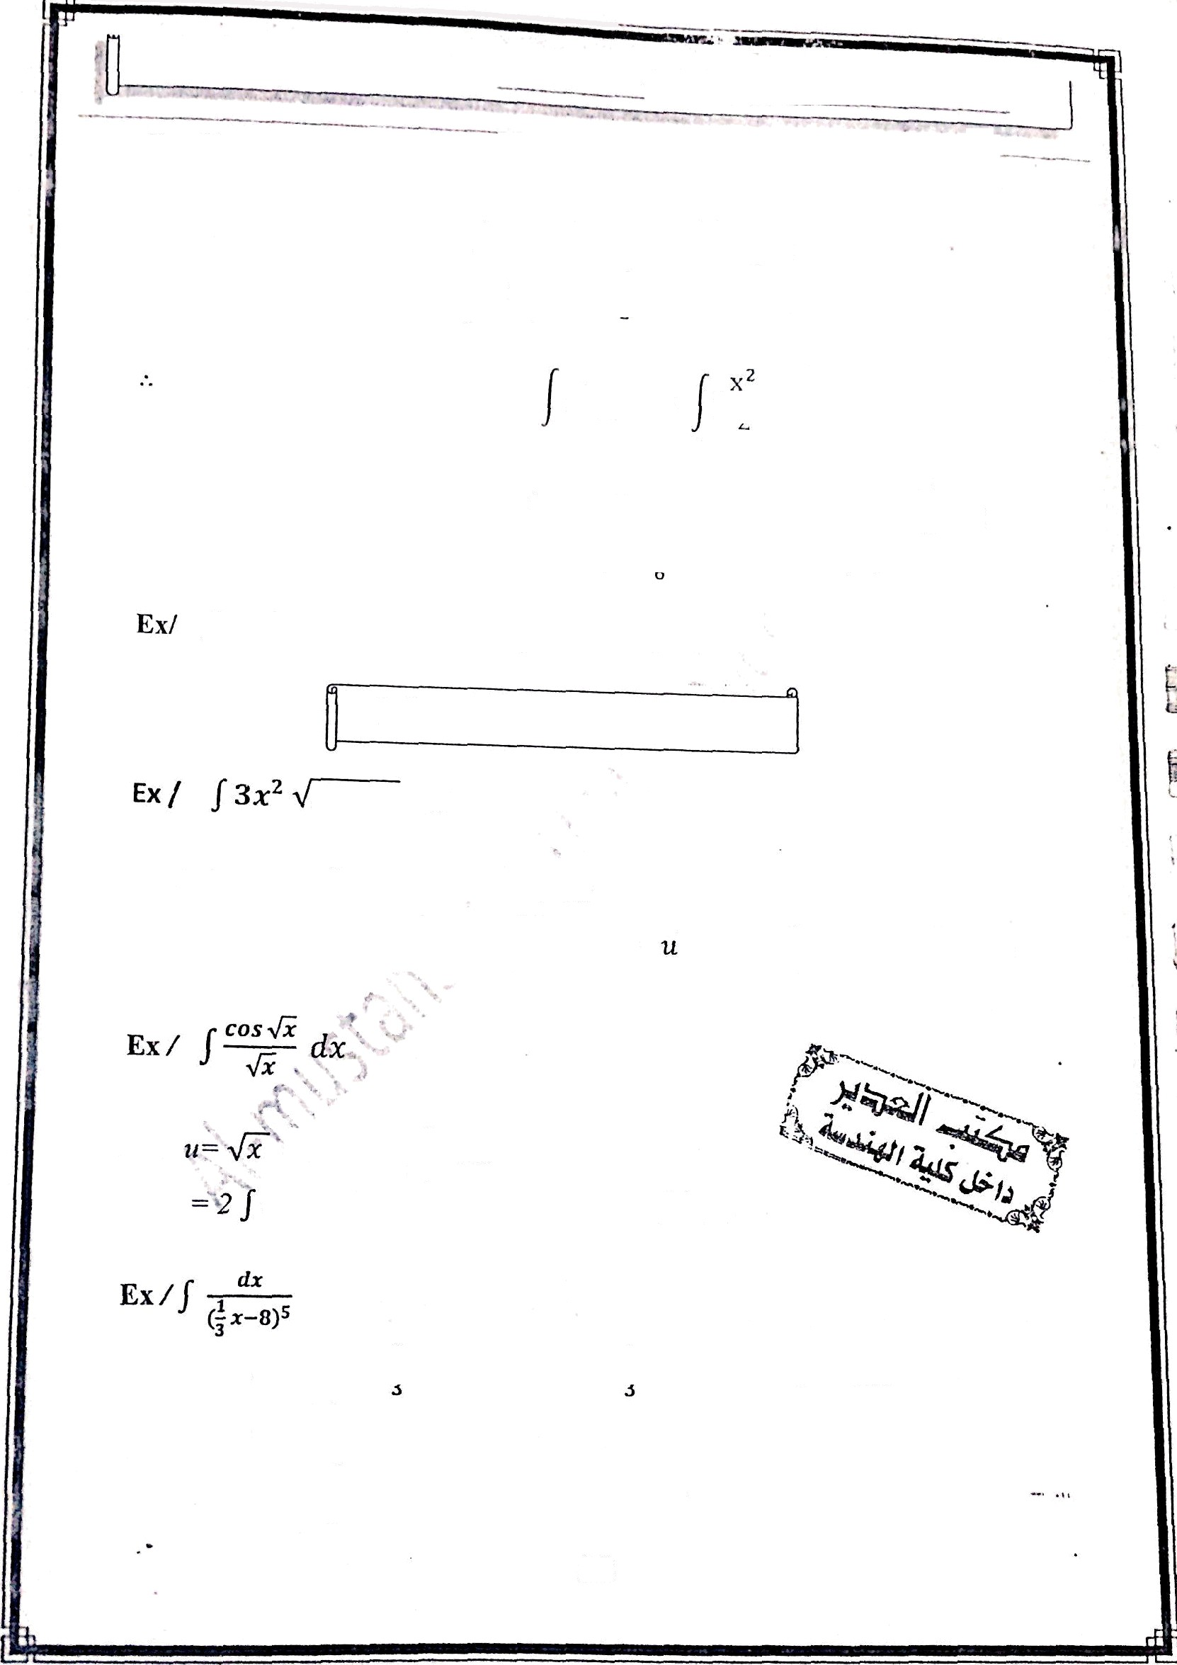





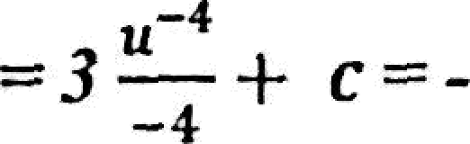
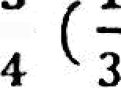

^{Assy.} leaf. : Abbas P. _{Al-shlmmg}
flat
i, f’(0)' 2
I
f' (x) ^{d}° -— J(
x + cosx )dx
(=) - ;- + sin x + c_{v}
- / (0) - o + o + , »,
f f› )^{d}^
f;x j -$
* f ⁰ ) 0
ff•J ,—
( p -1- sin x + z) dx
cosx -t zz + c₂
1 -r o + c₂
==> c₂ y
cosx H= 2z + 2
/r taI t²
dx
f(s ec ²
1 ) dx —— tarl x
-x + ’c
^{1-Integra}t^{i}on by substitution
x' + 1 dx
Let u
f •/ i du
x^ -F 1 »
/ u
du — 3x^dx
u” _{+ c}
’-
3/2
c--’- ( x
3
+ 1 )' '2 p
3/2
3
3
Let
==i du
ros U du
1
dx
2 sinu x c
3 sin•fil: -t c
Let u - * x
- f’g^{d}p’ -- 3 / u
8 =» du
) dx m 3e«
dx
8)“ + c
38

Slide 9

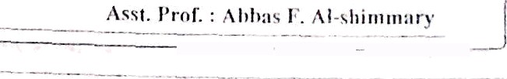









Ex z J ;r'
I(u + i)'
- L dx
Let it — x-1 =r x —— u + 1 dx —— di
du = J( u' + zu + H«'*' du
—= Ț( u' ' + 2 u' ² + u' ') dir
7
dv —— sec² 5x ( 5 dx )
— du —- sec’ 5x dx
( ¹ du)
1 u’
Ex f | f sect 2x: | rim 2z | dx
-= | sec’ 2z | sec 2z | (an 2x | dx
Let u—= sec 2x
du -- sec 2z ten 2s (2 dx ) y d,u - sec 2s tan 2z dx
² du
= u'
= ’$— + c -—’ ¿ (sec 2s )3 + c
Ex. J.[’’(- 2s
y’/ )2 Ż/3
-- J(2x — ₃₎ a/3 dx
Let u -- 2x-3 =r du -- 2dz
39

Slide 10
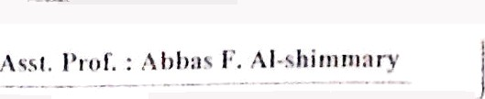





I (•) \ —— f(x) Then ’ f (x) ‹1. —— fi(I›) — /•”(‹z)
Ex / e\-alliatc
(x ’ — 4.r -I- j )r/x
2
— 18 + 3)
(0) =
4
Properties
]q‘ f(x) dx —— o
Jq f(x) dx —- J„’ (x) d.v
jb f(x) dx —- ]q f(x) dx + ]
f(x) dx if n < c < b
dx —— a
Ex / / ₄ x dz = —
Ex 1 J, x'
’zdz = — —
] = —8
2
Area under a curve:$
Ex Z find fire area under the curve
since cos x > 0 for
y-= cos x over the interval [
0 ñ z ñ ^/₂
a/z
/2
] — sin ( ^/ ₂ ) — sin(0) = 1 0
.-. A ——
cos x dz = sin x
°
40

